Slide 1

CULTURE
Culture is an integral aspect of human life, which influences the attitudes, actions and patterns of living of people in a society.
Culture is the sole possession of human beings and upon which they could be distinguished from other lower animals.
Culture is a system of learned behaviors shared by and transmitted among the members of a group.

Slide 2

Definition:
“Culture is that complex whole which includes knowledge, belief, art, morals, laws, customs and any other capabilities acquired by man as a member of society.” - E.B. Tylor. Stated more simply “culture is everything which is socially learned and shared by the members of society”.
2. “Culture is the totality of group ways of thought and action duly accepted and followed by a group of people.” – Walter Paul.

Slide 3

Characteristics of Culture:
Culture is learned/behavior. Most of the behavior is learned in society. This learning might be conscious or unconscious but nobody can deny the process of learning.
Culture is shared. All the cultural traits, attitudes, knowledge and material objects like radio, TV automobiles and computer etc are actually shared by members of society. However these material and non-material objects may not be equally shared by every member of society.
Culture is Ever-changing. Culture in every society is changing, but with different speed. Change in culture is inevitable e.g. man has landed on moon from the stone-age.

Slide 4

Characteristics of Culture:
Culture is Accumulative. Adding elements from generation to generation according to need and of time or borrowing from outside culture.
Culture is transmitted. Most of the cultural traits and material objects are transmitted to the members of society from their forefathers. for instance, we learn new fashions and political views how to move in society and how to behave in a particular social situation.

Slide 5

Types of CULTURE
Material culture refers to concrete objects created by human beings to satisfy their desires. These are external to human beings. Examples are tools, furniture, automobiles, buildings, utensils, etc.
Non-material culture refers to an abstract creation of man such as ideas, customs, beliefs, habits, morals, laws, knowledge, etc. These are internal to human beings and are acquired through process of learning.

Slide 6

Components of Culture
Values
Values are things or ideas liked by the people. OR
Social values refer to the group conceptions (ideas) or standards by which things (feeling, action, object and group) are compared and approved or disapproved relative to one another, held relatively desirable or undesirable, more or less meritorious.
As culture varies from society to society therefore values differ from society to society.
Examples of social/cultural values are faith in Islam, respecting elders and women, charity, non-violence, patriarchal tendency, respecting religious priest, freedom of speech, adult franchise, religious freedom social justice, non-discrimination, etc.

Slide 7
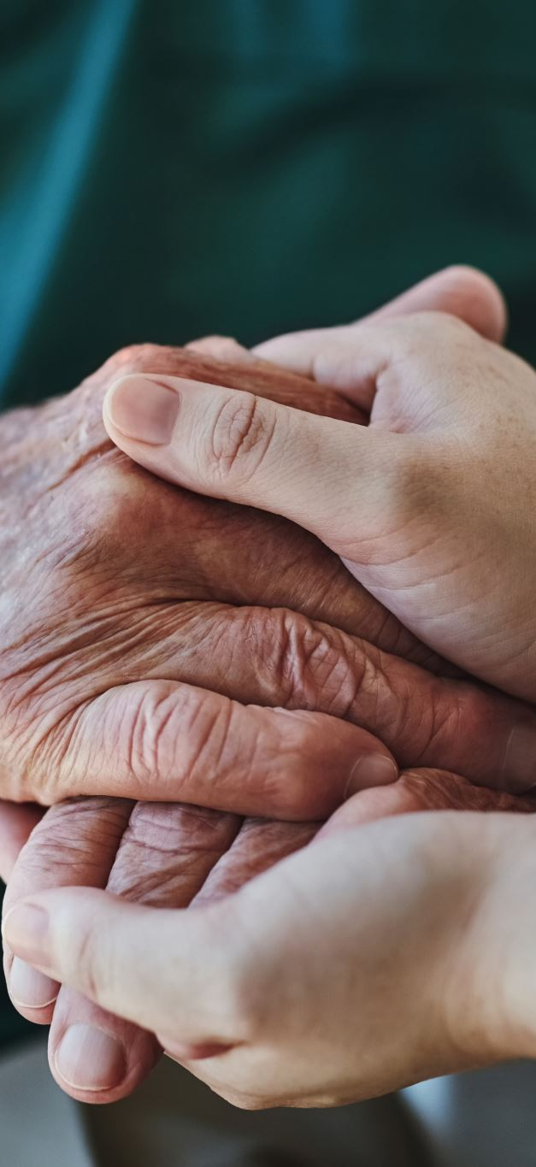
Components of Culture
NORMS
All societies have acceptable and unacceptable forms of behavior called social norms.
The standard of right and wrong in society are Social norms are.
Norms are the rules detailing what should or should not be done in a given situation.
They are the rules which prescribe what is socially acceptable or unacceptable in any social system.

Slide 8

Cultural Change
Culture change refers to the process by which a culture evolves, adapts, or transforms over time. It involves shifts in the beliefs, values, norms, practices, symbols, and artifacts that define a society or group. Culture change can occur gradually or rapidly and can be driven by internal or external factors. It is a natural and ongoing process, as cultures are dynamic and constantly influenced by new ideas, technologies, and interactions.

Slide 9
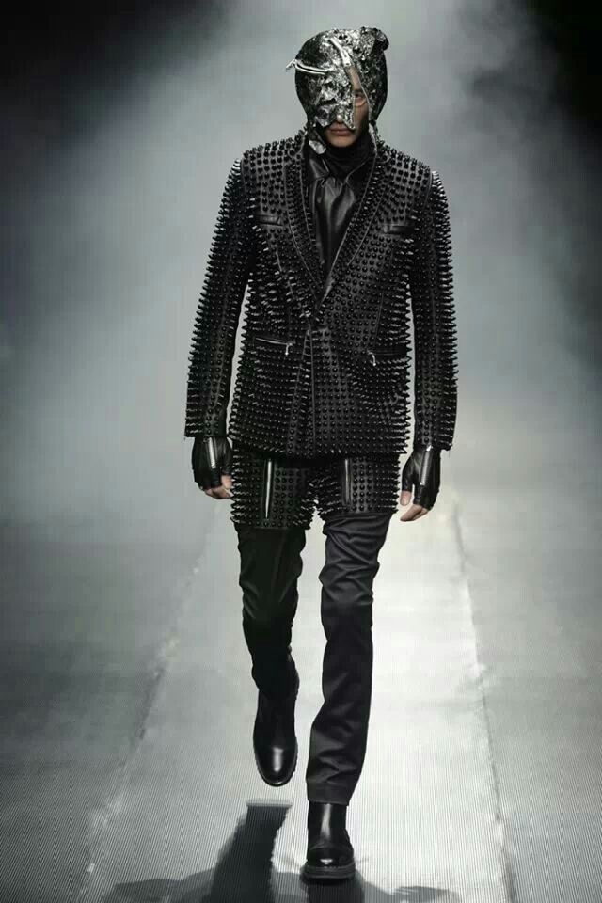
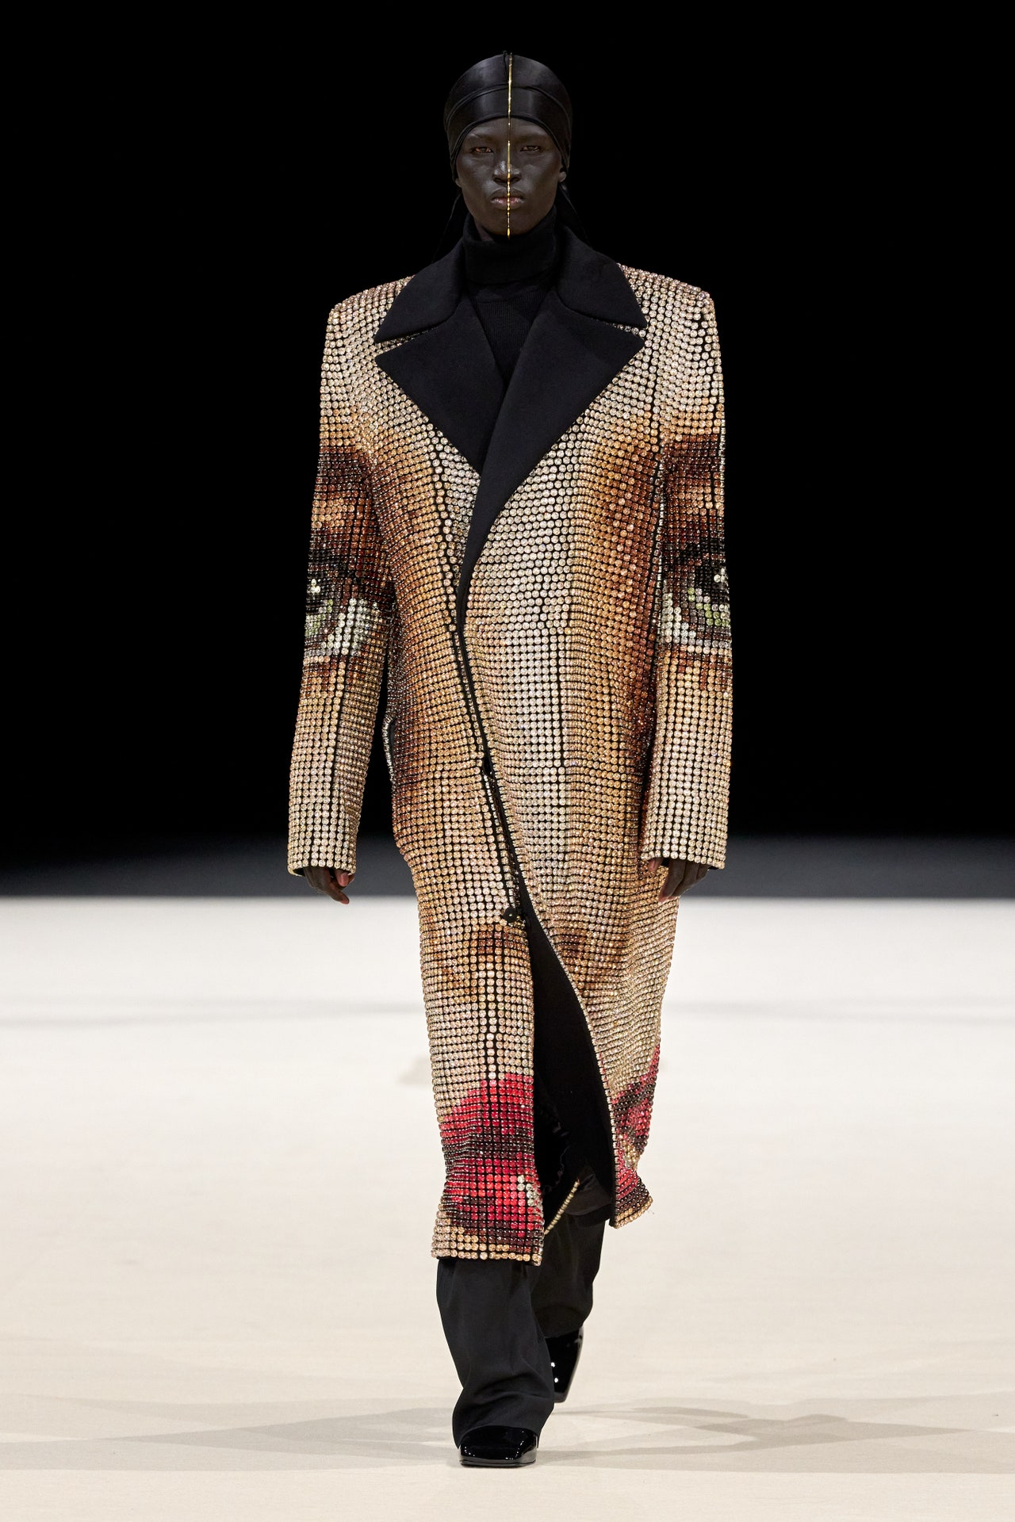
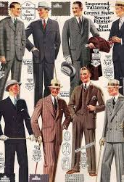
2024/ 1920

Slide 10
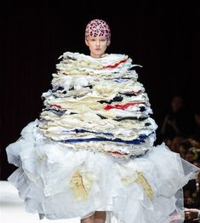
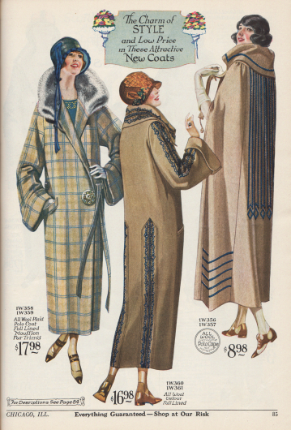
1920 2024

